Slide 1
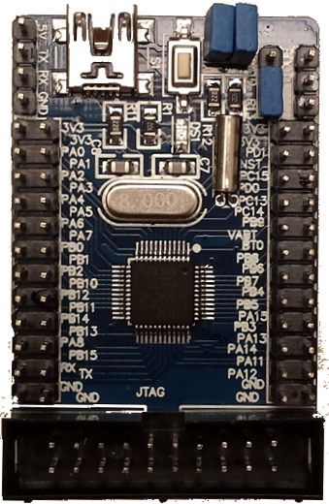
Power
5V
TX LNK_RX
Serial
RX LNK_TX
GND
BOOT_0
BOOT_1
AnalogIn
3V3
3V3
3V3
3V3
PA_0
PA_1
NST
PD_1
PA_2GPS_RX
PA_3GPS_TX
PD_0
PC_15
DigitalIn
PA_4 JOY_A1
PA_5JOY_A2
PC_14
PC_13
PA_6 JOY_B1
PA_7JOY_B2
VBAT
PB_9
PB_0 BUZZ
PB_1 OK_A
PB_8
BT_0
DigitalOut
PB_2 OK_B
PB_10
PB_7
PB_6 L-RTH
PB_12 LOC
PB_11 ARM
PB_5 L-ALT
PB_4
PwmOut
PB_14 RTH
PB_13 ALT
PB_3
PA_15
PA_8 L-ARM
PB_15 L-LOC
PA_14
PA_13
RX LNK_TX
TX LNK_RX
PA_12
PA_11
Not used
GND
GND
GND
GND

Slide 2
Power
5V
Serial
TX LNK_RX
RX LNK_TX
GND
BOOT_0
BOOT_1
AnalogIn
3V3
3V3
3V3
3V3
PA_0
PA_1
NST
PD_1
PA_2GPS_RX
PA_3GPS_TX
PD_0
PC_15
DigitalIn
PA_4 JOY_A1
PA_5JOY_A2
PC_14
PC_13
PA_6 JOY_B1
PA_7JOY_B2
VBAT
PB_9
PB_0 BUZZ
PB_1 OK_A
PB_8
BT_0
DigitalOut
PB_2 OK_B
PB_10
PB_7
PB_6 L-RTH
PB_12 LOC
PB_11 ARM
PB_5 L-ALT
PB_4
PB_14 RTH
PB_13 ALT
PB_3
PA_15
PwmOut
PA_8 L-ARM
PB_15 L-LOC
PA_14
PA_13
RX LNK_TX
TX LNK_RX
PA_12
PA_11
GND
GND
GND
GND
Not used

